Slide 1
Securitized Banking and the Run on Repo
Written by: Gary Gorton and Andrew Metrick
Presented by: Di Zhou

Slide 2
Background
The financial system has changed dramatically since the establishment of banking insurance in the US about 75 years ago.
The establishment of the FDIC largely ended commercial bank runs.
However, the vast majority of liquidity provision/maturity transformation now is done using other financial instrument, not protected by deposit insurance.
This paper explores the idea that a major form of liquidity provision is done through repo markets.
Like demand deposits at commerical banks, repo loans are runable

Slide 3
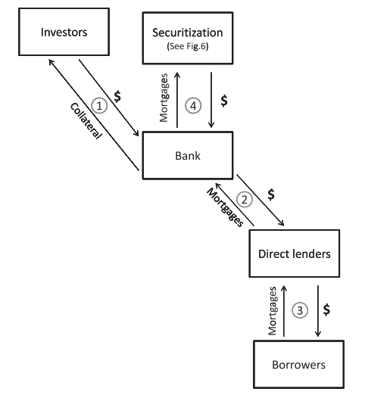
What is securitized banking?
Step1: the investor receives collateral from the bank. In practice, this deposit-collateral transaction takes the form of a repo agreement
Step2: outsources the loan underwriting function to direct lender
Step3: direct lender underwrites loans to borrowers
Step4: the intermediation activities that transfer most of the mortgage loans to outside investors in Step 4.used as collateral
Notes:
In practice, this deposit-collateral transaction takes the form of a repo agreement: the investor buys some asset (i.e., the collateral) from the bank for $X, and the bank agrees to repurchase the same asset some time later (perhaps the next day) for $Y. The percentage (YX)/X is the repo rate, and is analogous to the interest rate on a bank deposit.
For our purposes here, the key idea is that the outputs of this securitization are often used as collateral in Step 1, so that securitized banking is a cycle that requires all steps to keep running. In this paper, we show how this cycle broke down in the crisis.

Slide 4
What is Repo?
A repurchase agreement( or repo) is a financial contract used by market participants as a financing method to meet short-term liquidity needs.
It is a two-part transaction. The first part is the transfer of specified securities by one party, the bank or borrower, to another party, the depositor or lender, in exchange for cash the depositor holds the bond, and the bank holds the cash.
The second part of the transaction consists of a contemporaneous agreement by the bank to repurchase the securities at the original price, plus an agreed upon additional amount on a specified future date.
Notes:
if an asset has a market value of $100 and a bank sells it for $80 with an agreement to repurchase it for $88, then we would say that the repo rate is 10% [¼(8880)/80] and the haircut is 20% (10080/100). If the bank defaults on the promise to repurchase the collateral, then the investor has the right to terminate the agreement and keep or sell the collateral.

Slide 5
Securitization
An important part of the subprime mortgage innovation was how the mortgages were financed. In 2005 and 2006, about 80% of the subprime mortgages were financed via securitization, that is, a mortgage was sold in as part of a residential mortgage-backed security (RMBS), which involves pooling thousands of mortgages together, selling the pool to a special purpose vehicle (SPV) which finances their purchase by issuing investment-grade securities (i.e., bonds with ratings in the categories of AAA, AA, A, and BBB) with different seniority (called tranches) in the capital markets. Securitization does not involve public issuance of equity in the SPV. SPVs are bankruptcy remote in the sense that the originator of the underlying loans cannot claw back those assets if the originator goes bankrupt. Also, the SPV is designed so that it cannot go bankrupt.

Slide 6
Types of Securitization
Collateralized Debt Obligations (CDO)
Asset Back Securities (ABS)
Commercial Mortgage Backed Securities (CMBS)
Residential Mortgage Backed Securities (RMBS)

Slide 7
Purpose of this paper
Theory: Can securitized bank runs exist?
Empirical: Are increasing haircuts, as measured here, a good proxy for a run?
Magnitudes: Was a repo-run the cause of the financial crisis?
We refer to the combination of securitization plus repo finance as ‘‘securitized banking’’ and argue that these activities were at the nexus of the crisis. We use a novel data set that includes credit spreads for hundreds of securitized bonds to trace the path of the crisis from subprime-housing related assets into markets that had no connection to housing. We find that changes in the LIB-OIS spread, a proxy for counterparty risk, were strongly correlated with changes in credit spreads and repo rates for securitized bonds. These changes implied higher uncertainty about bank solvency and lower values for repo collateral.

Slide 8
what is a bank run?
Diamond & Dybvig (1983) develop a model of (commercial) bank runs.
There are two principal players in their model:
  The borrowers (businesses) want to make long-term illiquid investments. If they hold the loan to maturity, the return is high. If they are forced to liquidate the investments early, the payoff will be low.
  The lenders (depositors) have capital to invest, but are sometimes faced with liquidity shocks.

Slide 9
Bank Runs
Depositor’s liquidity are shocks idiosyncratic so, because of diversification, banks generally can meet all withdrawls.
However, if the withdrawls are large, even a healthy bank can fail. in this case, it cannot pay its depositors in full. Knowing this, investors “rush for the exits” if they think that others are withdrawing capital.
You need to get your capital out before the bank runs out of reserves. After that, if the bank liquidates assets, it still won’t be enough to pay off all depositors

Slide 10
Repo-Market Runs
Since securitized lending is collateralized, one would think that runs couldn’t occur. If the borrower were to default, the lender would receive the collateral (i.e.,, ABS), which could then be sold on the open market.
The problem arises if the market for the collateral disappears. This could happen if everyone who had information about the collateral had no capital. This is implausible for repos of treasuries/agency securities, but probably not for specialized ABS’s.

Slide 11
Haircuts
Lenders only receive collateral in the case of failures.
  the lender has a put option.
Thus, to break even, the lender will only be willing to lend the risk adjusted expected value of the collateral, conditional on a failure to deliver.
An implication is that we should expect to see large haircuts, but only while there is a lemons problem.
Once assets are being sold at fire sale prices, haircuts will fall to zero.
  The price is equal to the value of the collateral, conditional on the borrowers’ failure as a group.

Slide 12
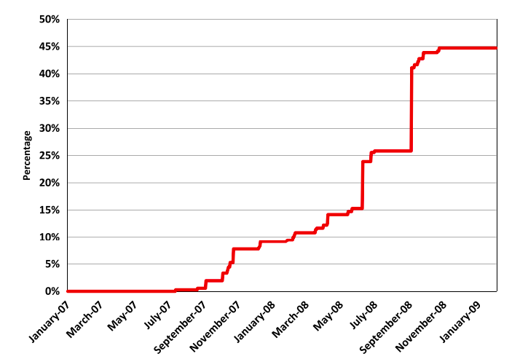
Repo hair-cut
Notes:
unprecedent high repo haircuts; cession of repo lending on many forms of collateral

Slide 13
State Variables
ABX: Proxies for fundamentals of the subprime market . Credit derivative that references 20 equal weighted subprime RMBS tranches. Thus, for our purposes the ABX indices are important because of the information revelation about the value of subprime mortgages, which in turn depends on house prices.
BBB ABX tranche of the first vintage of the ABX in 2006 : riskier levels of subprime securitization
OIS: a measure of interest rate expectations over the same term
LIB-OIS Spread: the state of the interbank market and, in particular, the repo market. It is the spread between three-month LIBOR and the overnight index swap rate
Can be though of as a proxy for countrparty risk in repo transactions
Used for fears about bank insolvency
Used for the state of the interbank market(repo market)

Slide 14
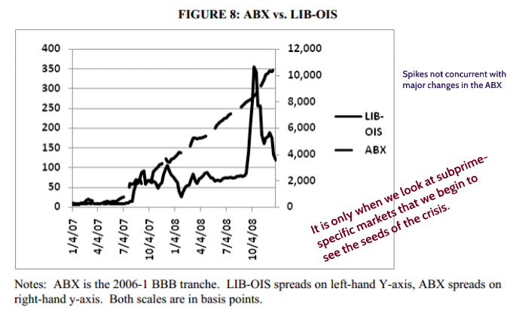
two state variables vs the time line of the crisis
Notes:
The ABX data show that the deterioration of the subprime market began in early 2007. As is now well known, this deterioration had a direct impact on banks, which had many of these securitized assets and pre-securitized mortgages on their balance sheets. This real deterioration in bank balance sheets became apparent in the interbank markets in mid2007, as evidenced by an upward spike in the LIB-OIS in August. This state variable remained in a historically high but narrow range until September 2008, when the events at Fannie Mae (Federal National Mortgage Association), Freddie Mac (Federal Home Loan Mortgage Corporation), Lehman, and AIG (American International Group Inc.) led to a rapid deterioration in interbank markets and increase in the LIB-OIS spread that persisted until the end of 2008.

Slide 15
Summary
The first systematic event occurs in August 2017, with a shock to the repo market that we demonstrate using the LIB-OIS.
The market slowly became aware of the risks associated with the subprime market, then it led to doubts about repo collateral and bank solvency.
After August 2007, the securitized-banking model was under pressure, with small equity bases stretched by increasing haircuts on high-grade collateral. We see evidence of this pressure in the co-movement of spreads on a wide variety of AAA and AA credits. This pressure contributed to the forced rescue of Bear Stearns in March 2008 and the failure of Lehman Brothers in September 2008. The second systemic event and run on repo occurred with the failure of Lehman.
Notes:
The first systemic event occurs in August 2007, with a shock to the repo market that we demonstrate using the LIB-OIS, the spread between the LIBOR and the OIS, as a proxy. The reason that this shock occurred in August 2007, as opposed to any other month of 2007, is perhaps unknowable. We hypothesize that the market slowly became aware of the risks associated with the subprime market, which then led to doubts about repo collateral and bank solvency. At some point (August 2007 in this telling) a critical mass of such fears led to the first run on repo, with lenders no longer willing to provide shortterm finance at historical spreads and haircuts. After August 2007, the securitized-banking model was under pressure, with small equity bases stretched by increasing haircuts on high-grade collateral. We see evidence of this pressure in the co-movement of spreads on a wide variety of AAA and AA credits. This pressure contributed to the forced rescue of Bear Stearns in March 2008 and the failure of Lehman Brothers in September 2008. The second systemic event and run on repo occurred with the failure of Lehman. In this second event, we see parallels to 19th century banking crises, with a famine of liquidity leading to significant premia on even the safest of assets.

Slide 16
Basel III
Pillar I: Enhanced Minimum Capital and Liquidity Requirements
Pillar II: Enhanced Supervisory Review Process for Firm-wide Risk Management and Capital Planning
Pillar III: Enhanced Risk Disclosure & Market Discipline

Slide 17
Thank you!

